Slide 1

The Extensive Guide to Using VMware Documentation Like a Pro
Boston VMUG UserCon
September 25, 2019
Nick Korte (@NetworkNerd_)
Notes:
Photo credit - pixabay

Slide 2
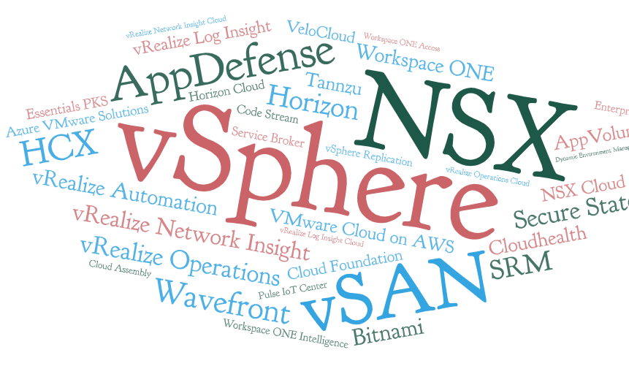
The Growing Portfolio
General documentation
Product-specific
Knowledge Base
Blog
Training
Video / Walkthrough
Notes:
What kind of documentation exists for what we have today?

Slide 3

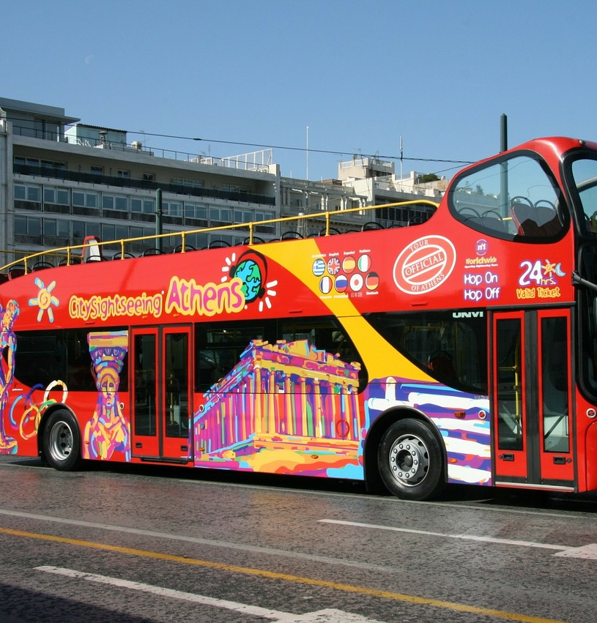

We’re Going on Tour!

Slide 4
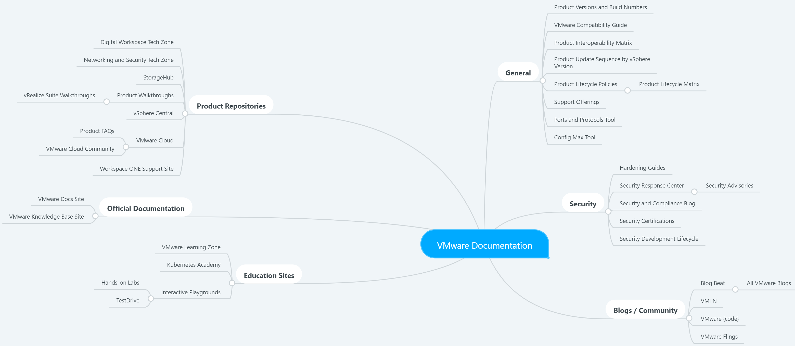
A Documentation Map https://mm.tt/1334759372?t=5ycwbDDXo1

Slide 5
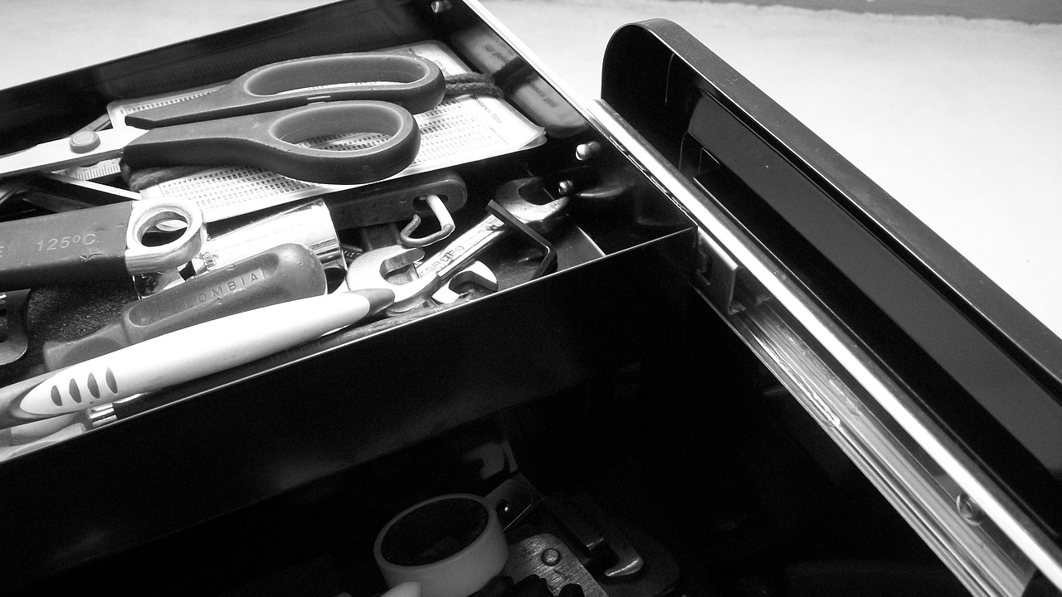
Tour Stop # 1
A General Toolset

Slide 6
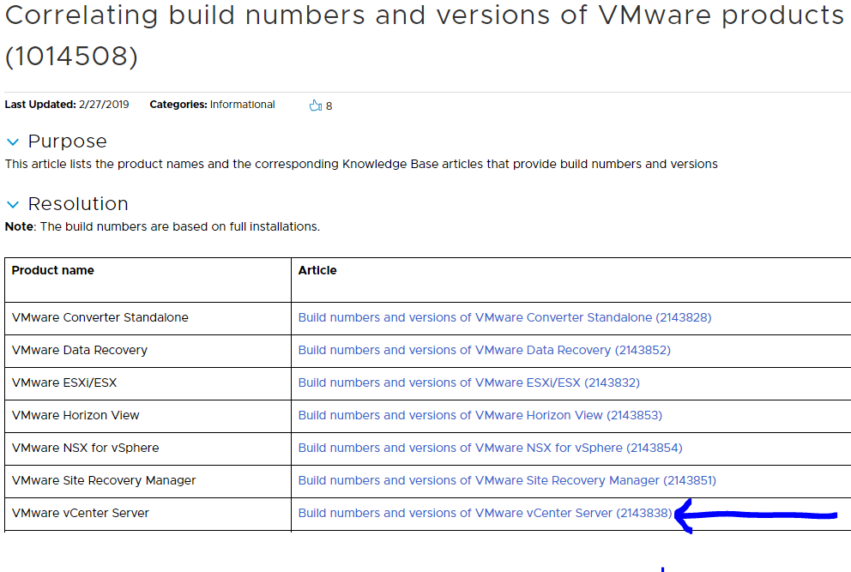
Build Numbers and Versions – KB 1014508

Slide 7
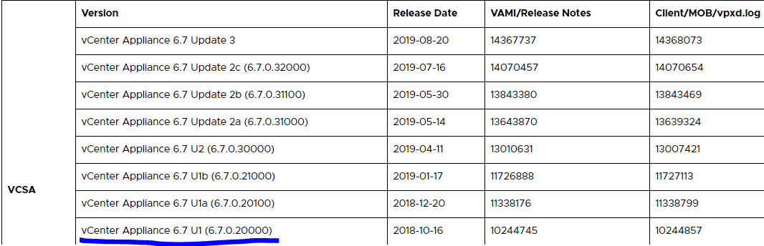
Build Numbers and Versions – KB 1014508

Slide 8
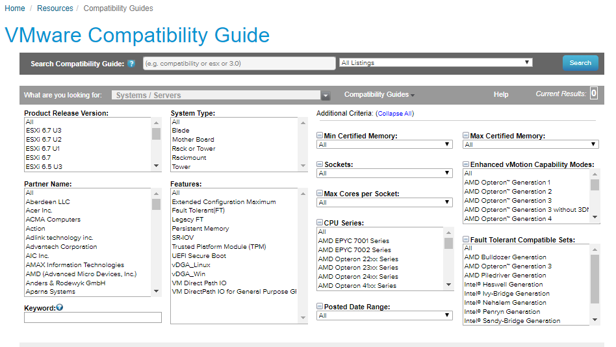
The VMware Compatibility Guide
Notes:
Some might call it the HCL
Page link - https://www.vmware.com/resources/compatibility/search.php

Slide 9
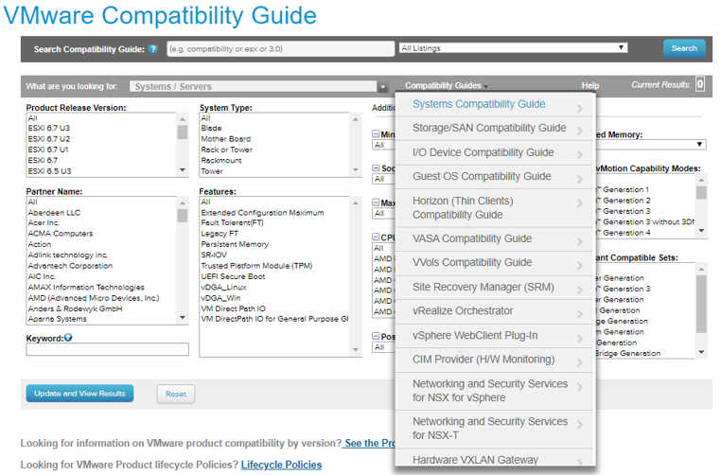
The VMware Compatibility Guide
Notes:
The secret menu?

Slide 10
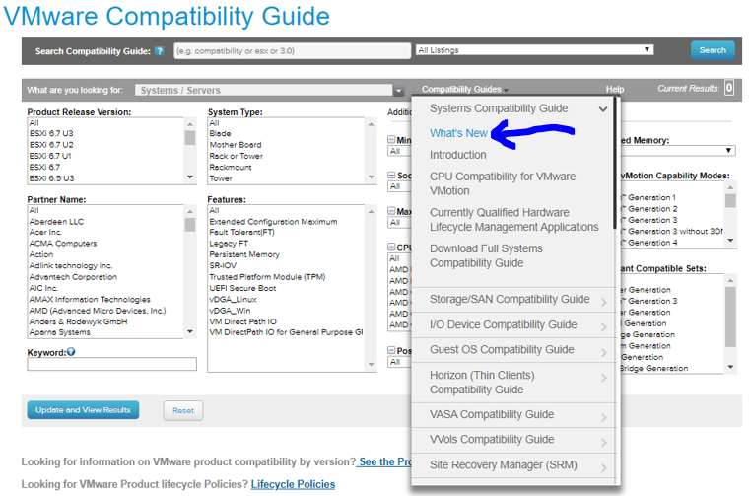
The VMware Compatibility Guide – Secret Menu?
Notes:
Some might call it the HCL

Slide 11
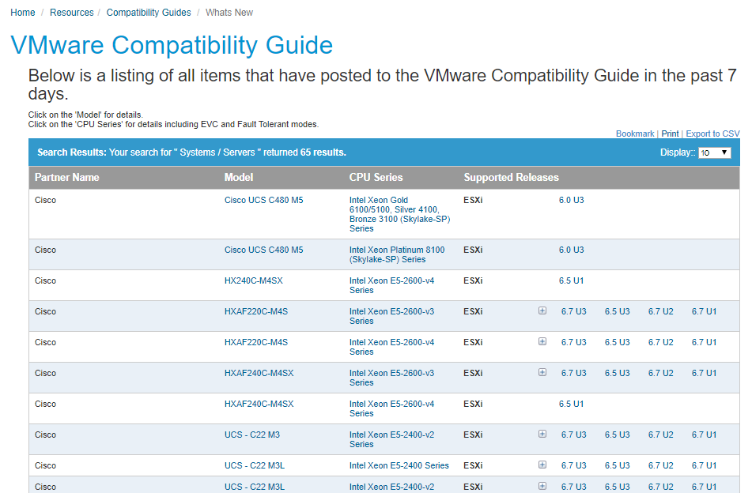
The VMware Compatibility Guide – What’s New?
Notes:
Some might call it the HCL

Slide 12
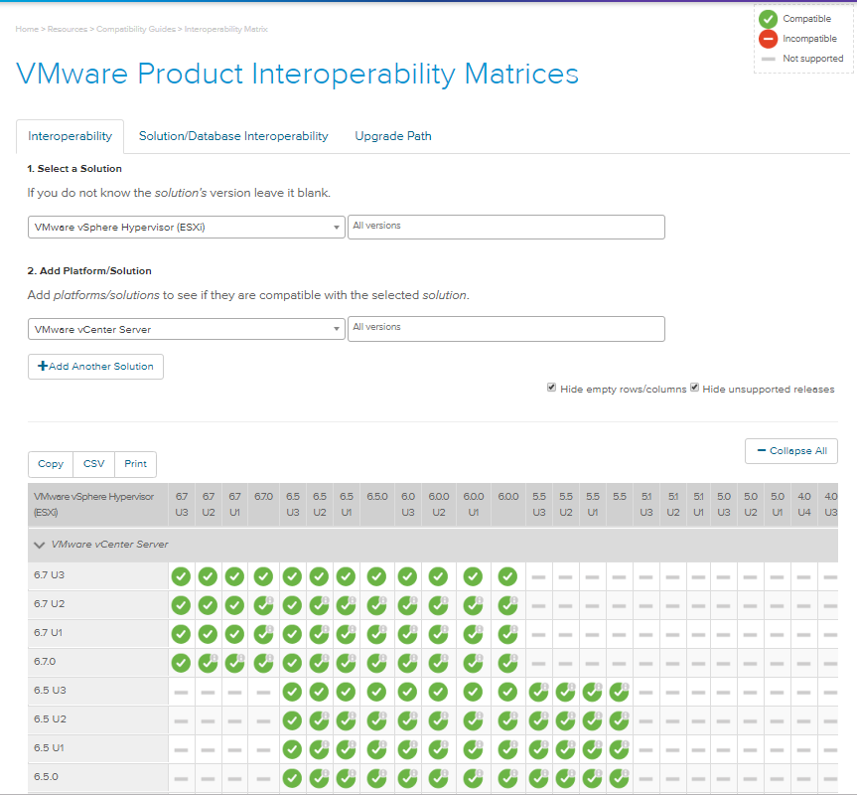
Product Interoperability
Example: ESXi and vCenter
Notes:
Easy to add more than 2 products
Can specify versions if you like
Might be some products not there but many are (including VMC on AWS)

Slide 13
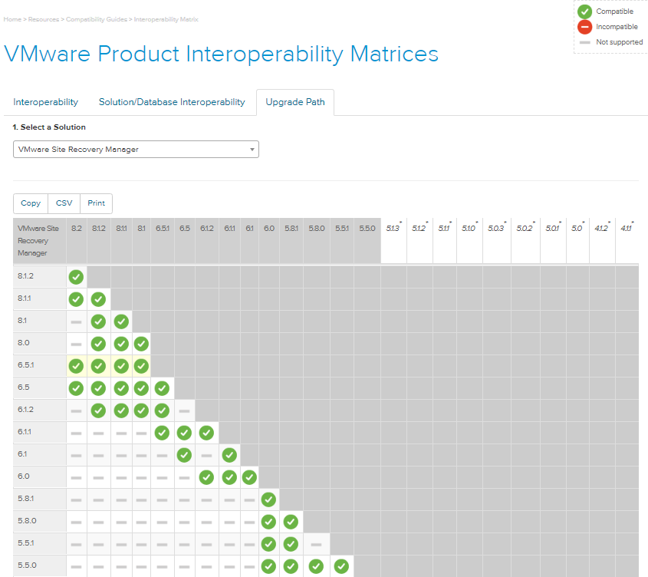
Product Interoperability and Upgrades
Example: Upgrading SRM

Slide 14
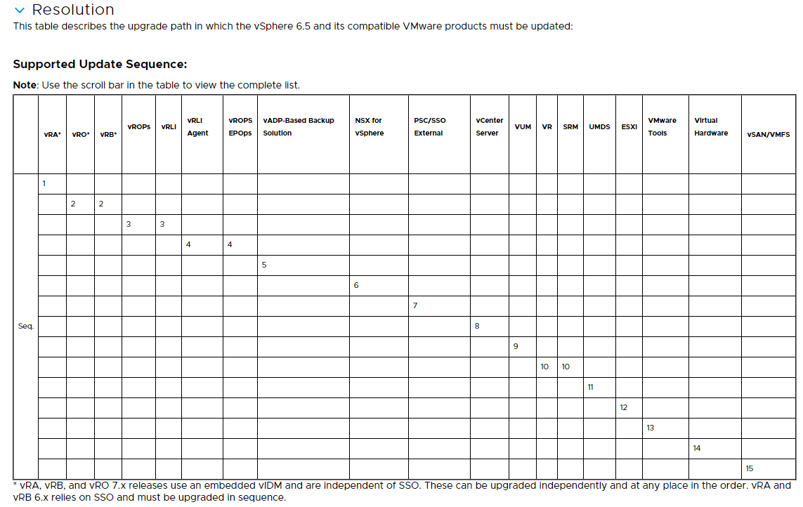
Update Sequence
Example – KB 2147289 (vSphere 6.5)
vSphere 6.0 – KB 2109760
vSphere 6.7 - KB 53710

Slide 15
VMware Product Lifecycle Policies https://www.vmware.com/support/policies/lifecycle.html
General Support Phase
Technical Guidance Phase
End of Support Life
End of Availability / End of Distribution
Notes:
General Support = starts on GA date and lasts for specific time, includes maintenance updates and upgrades, bug and security fixes, and tech support per the support terms and conditions
Technical Guidance = if available, usually web / e-mail support only (no phone) for low severity issues, no new hardware support / security patches / bug fixes unless called out specifically
End of Support Life = no longer supported by VMware (could be end of general support or end of technical guidance)
End of availability = we no longer sell it
End of distribution = no longer allow it to be downloaded

Slide 16
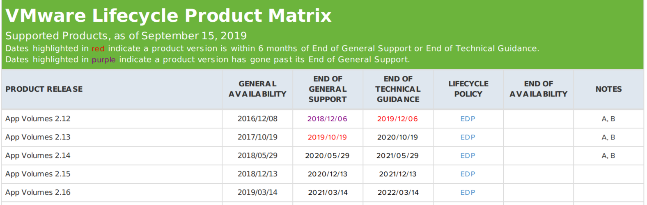
VMware Lifecycle Product Matrix https://www.vmware.com/content/dam/digitalmarketing/vmware/en/pdf/support/product-lifecycle-matrix.pdf
Notes:
Also lists unsupported products and their end of availability, etc.
Lifecycle policy defined on product lifecycle policy page - https://www.vmware.com/support/policies/lifecycle.html

Slide 17
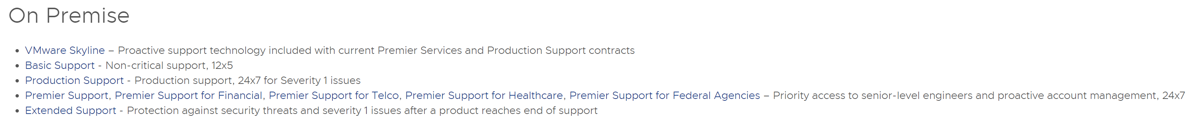
VMware Support Offerings https://www.vmware.com/support/services.html
Product support matrix - https://www.vmware.com/content/dam/digitalmarketing/vmware/en/pdf/support/support-by-product-matrix.pdf
Notes:
Similar story for SaaS support

Slide 18
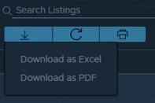
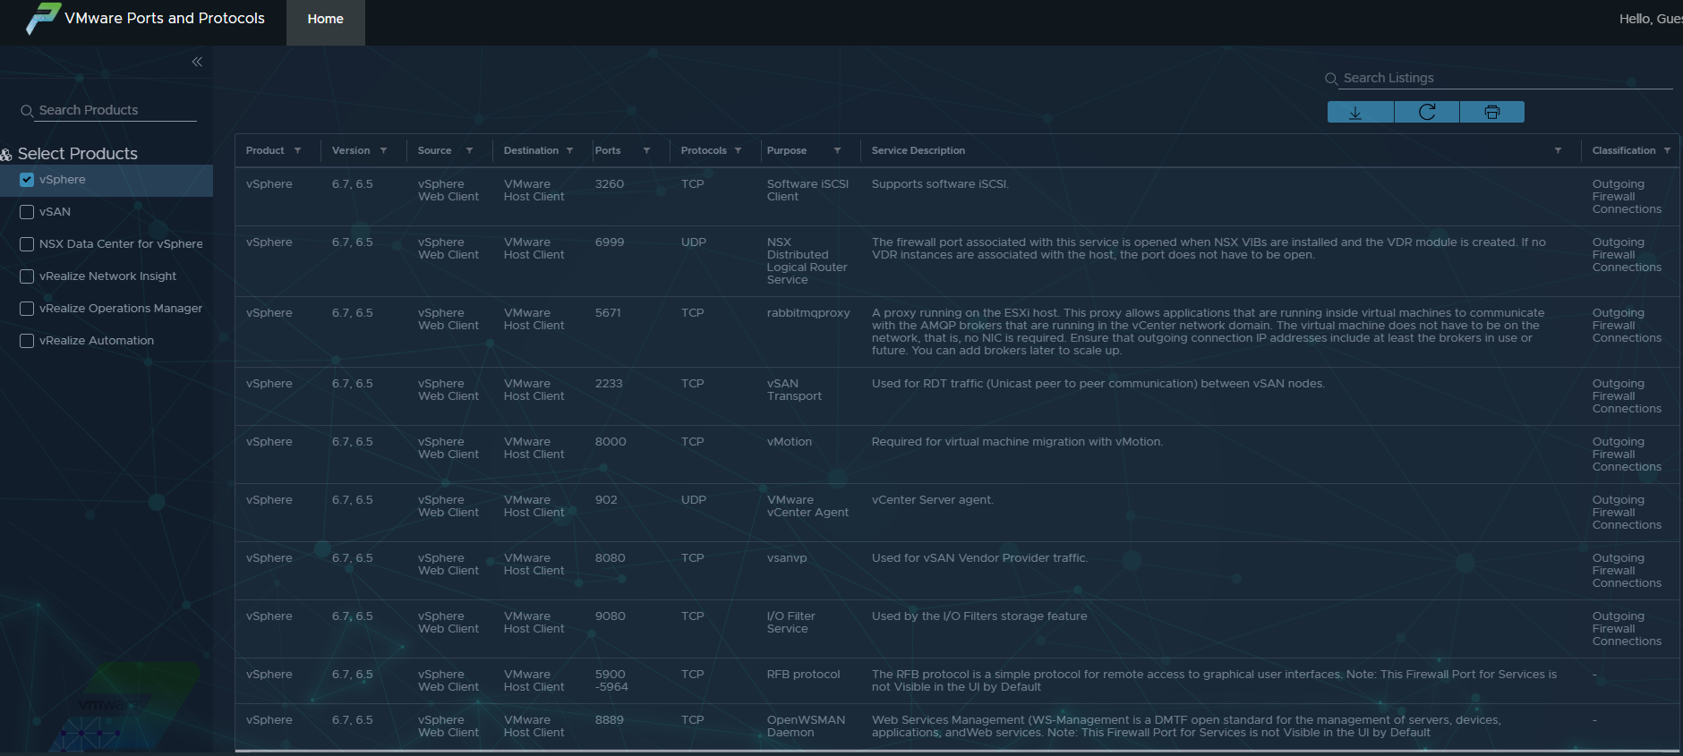
VMware Ports and Protocols https://ports.vmware.com/home

Slide 19
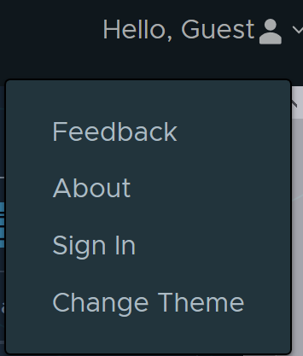
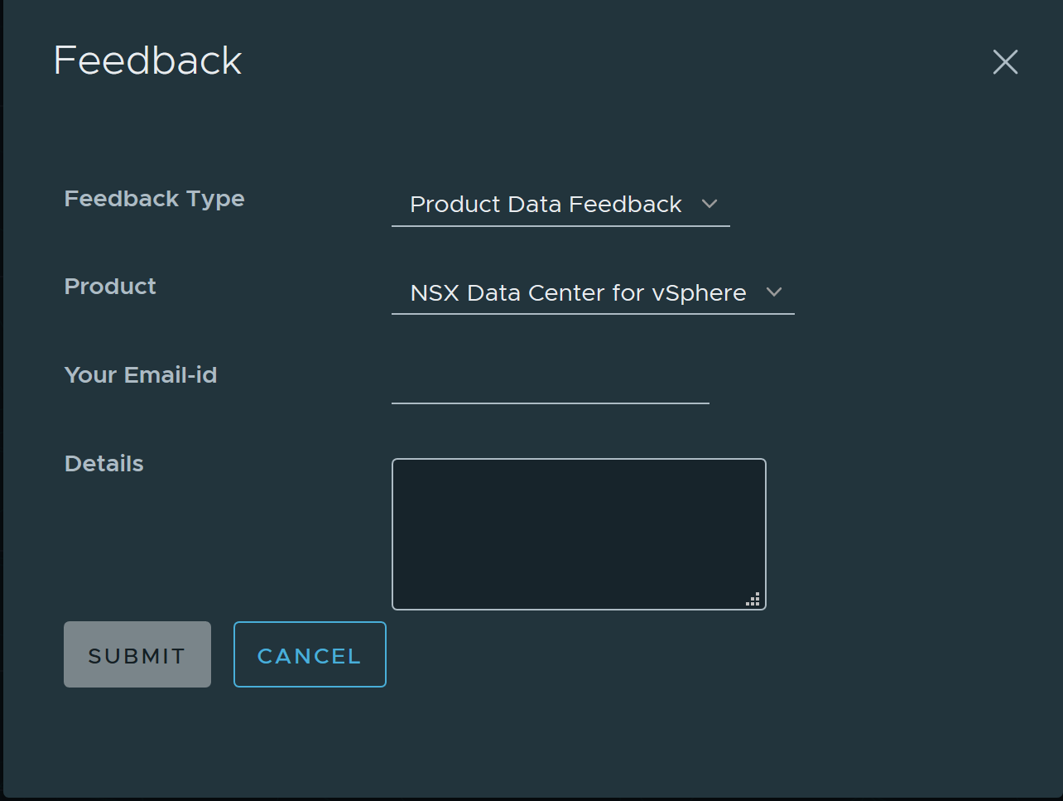
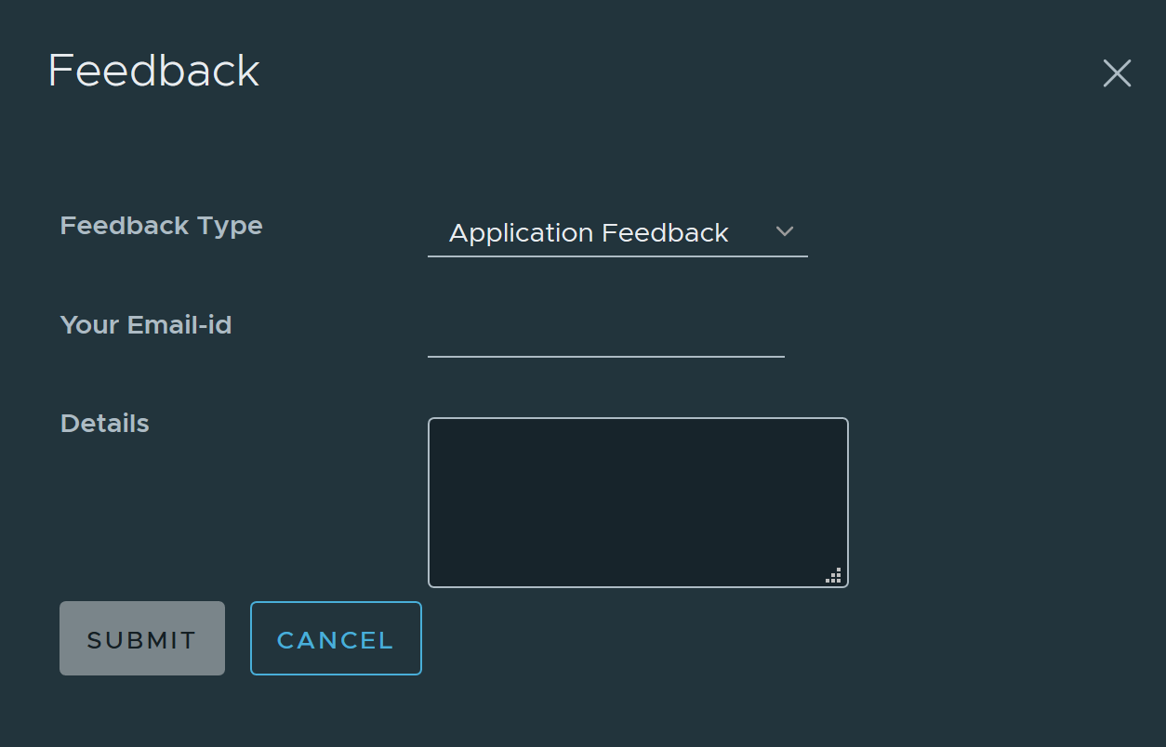
VMware Ports and Protocols - Feedback https://ports.vmware.com/home

Slide 20
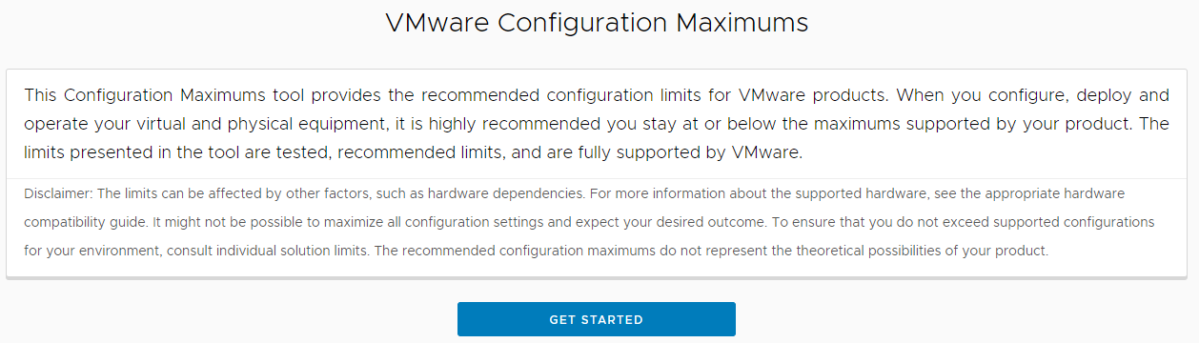
Config Max Tool https://configmax.vmware.com/home

Slide 21
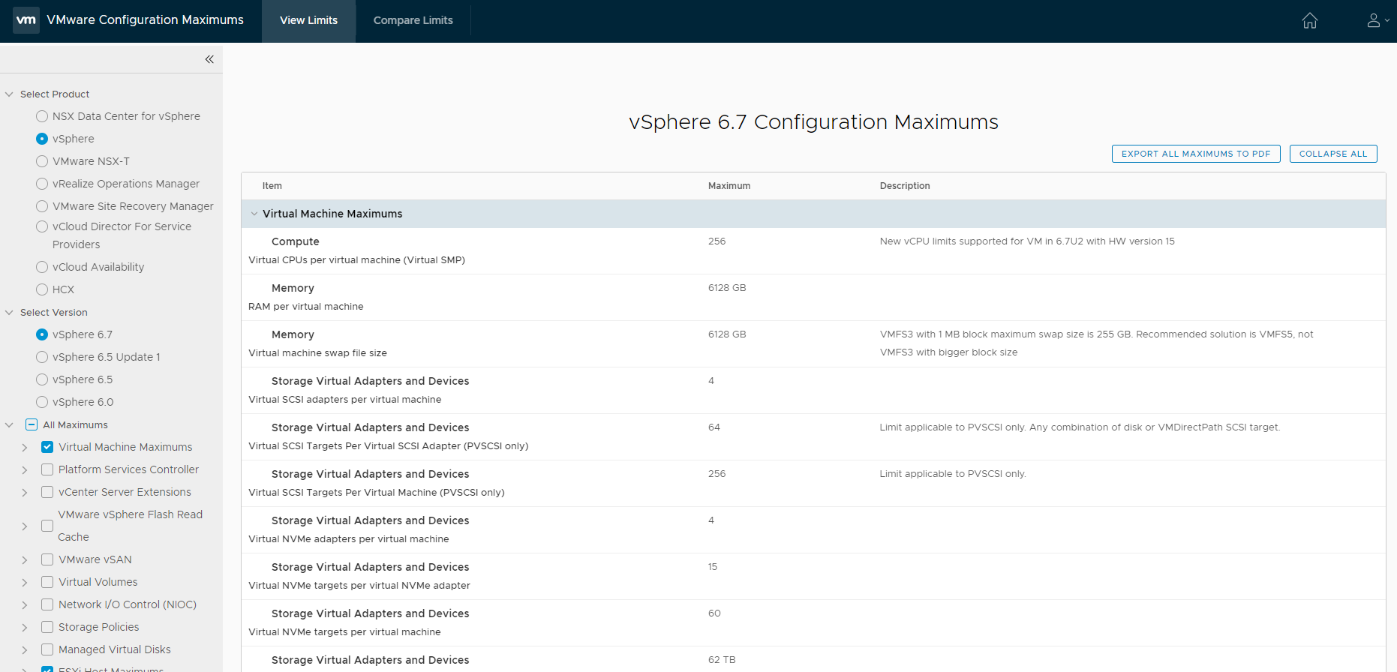
Config Max Tool – A Single Product https://configmax.vmware.com/home

Slide 22
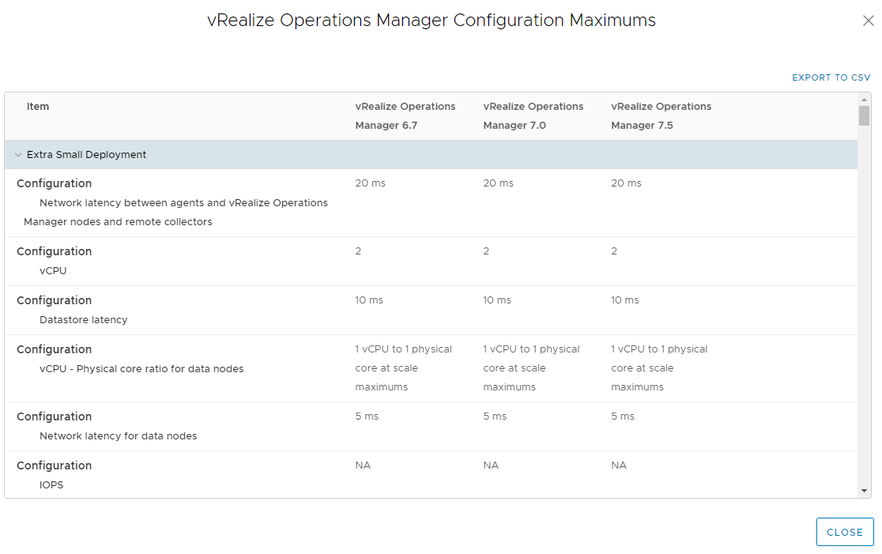
Config Max Tool – Making Comparisons https://configmax.vmware.com/home

Slide 23
VMware Product Guide https://www.vmware.com/content/dam/digitalmarketing/vmware/en/pdf/product/vmware-product-guide.pdf
A guide to license terms and conditions for on-premises products that is regularly updated
As a compliment to this guide, the VMware EULA for on-premises products and Terms of Service for cloud and hosted services can be found here - http://www.vmware.com/download/eula

Slide 24
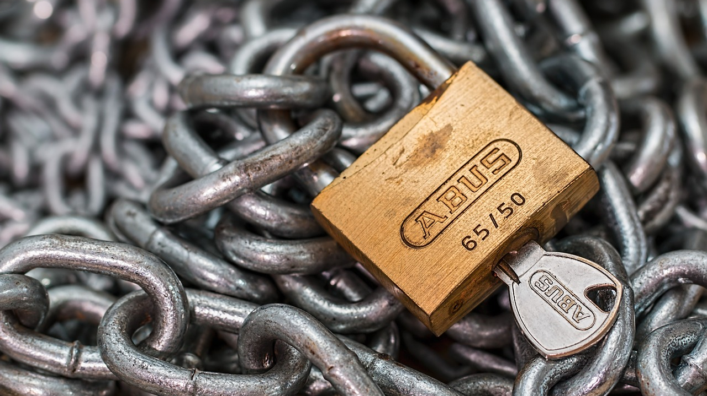
Tour Stop # 2
Security

Slide 25
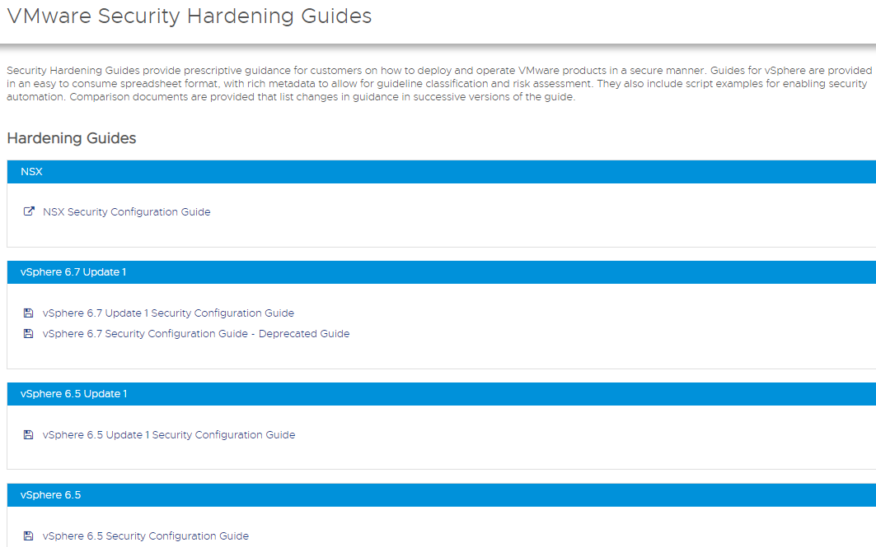
Security Hardening / Security Configuration https://www.vmware.com/security/hardening-guides.html
Notes:
Switched to Security Configuration Guide in vSphere 6.5

Slide 26
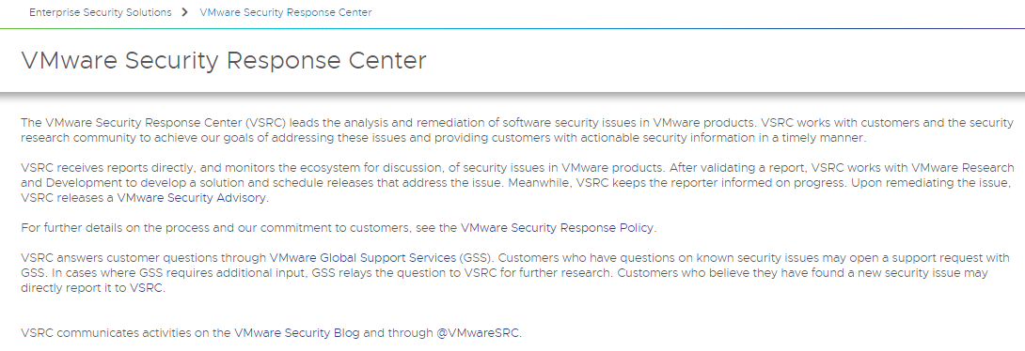
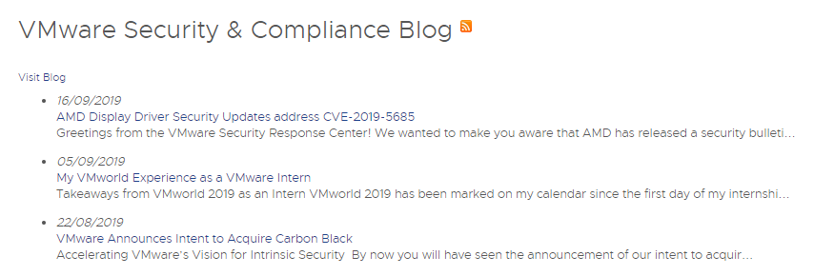
Security Response Center https://www.vmware.com/security/vsrc.html
Notes:
Read up on the security response policy for classes of vulnerabilities (critical, important, moderate, low)

Slide 27
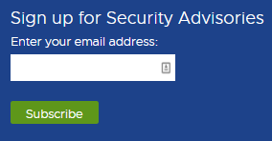
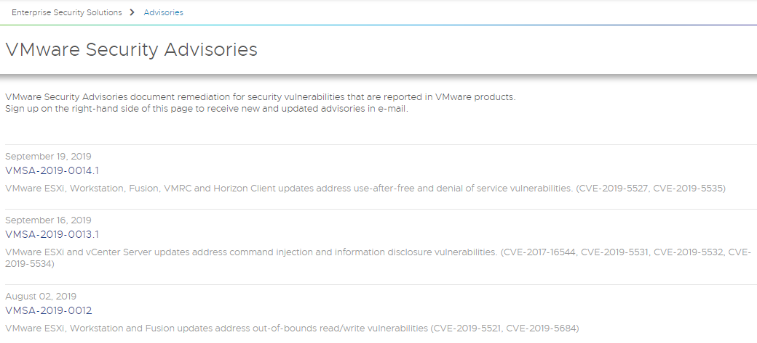
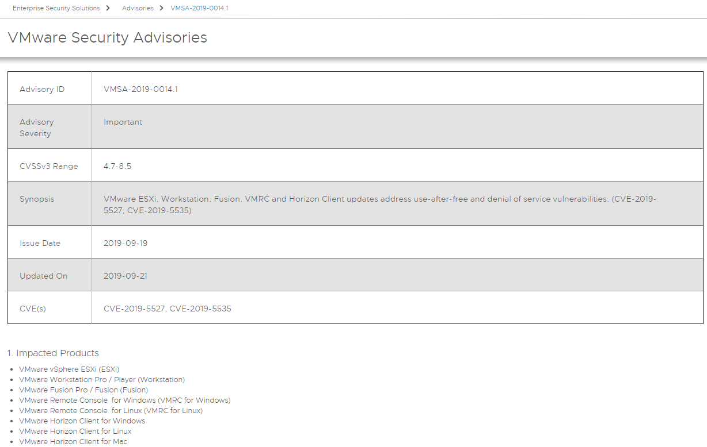
VMware Security Advisories https://www.vmware.com/security/advisories.html
Notes:
Can sign up on Security Response Center page

Slide 28
More Security Stuff…
Security Development Lifecycle
https://www.vmware.com/security/sdl.html
VMware Security Certifications
https://www.vmware.com/security/certifications.html
Notes:
Development lifecycle = methodology for developing secure software, standard security practices
The VMware Security Development Lifecycle (SDL) is our methodology for developing secure software through required and recommended activities that help product teams develop more secure code. These activities follow standard security practices including product security assessments, threat modeling, static and dynamic scans, and penetration testing.
Example of security cert – cryptographic modules in vSphere are FIPS compliant

Slide 29
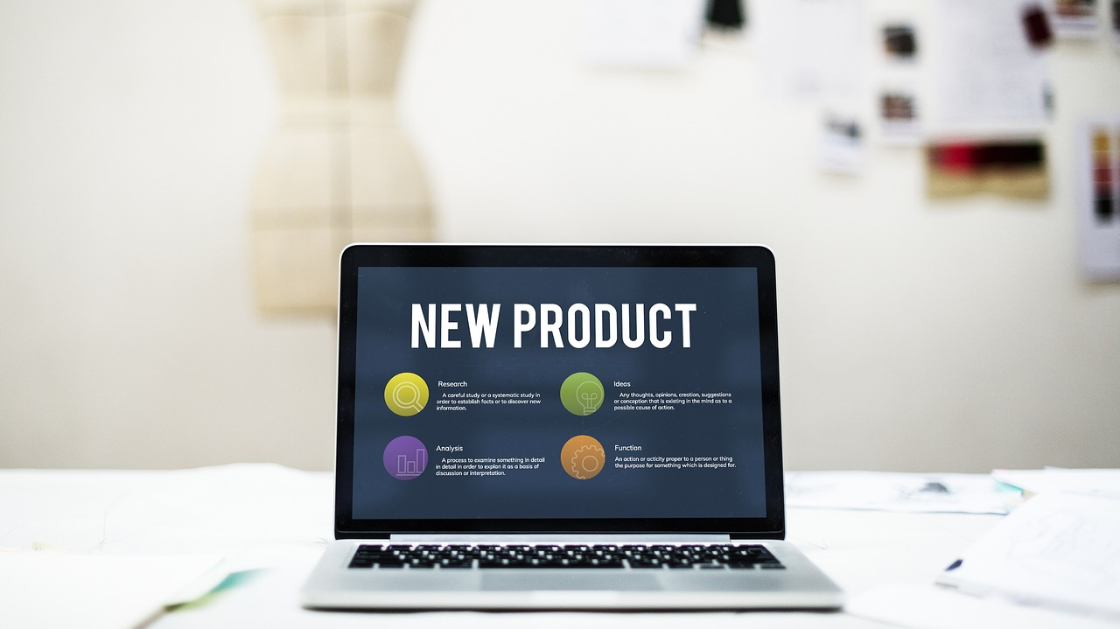
Tour Stop # 3
Product Repositories

Slide 30
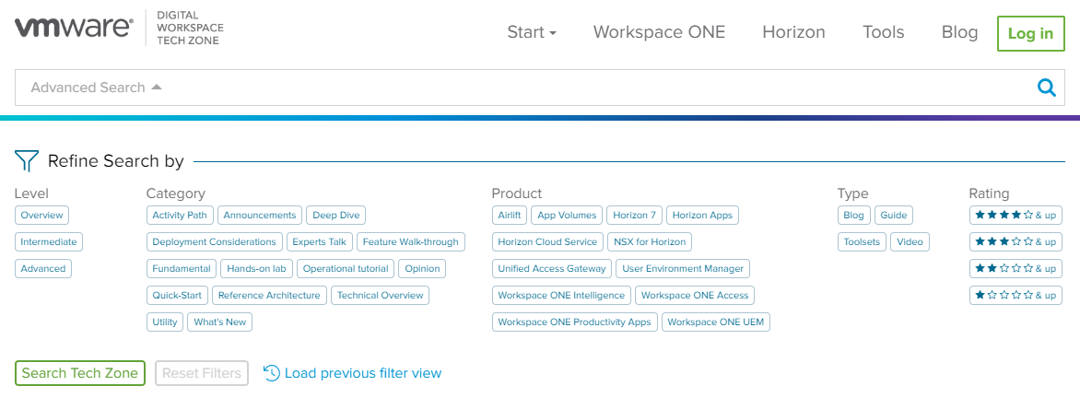

Digital Workspace Tech Zone https://techzone.vmware.com
Notes:
Login with your myvmware.com id!

Slide 31
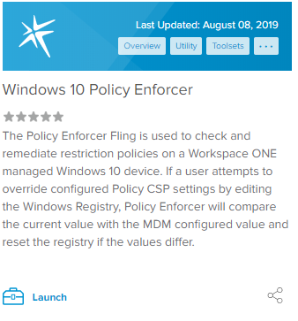
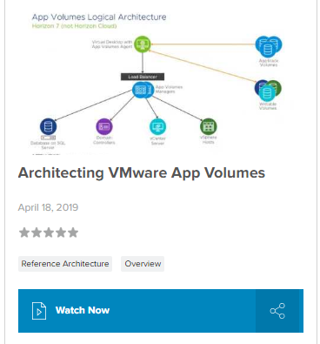
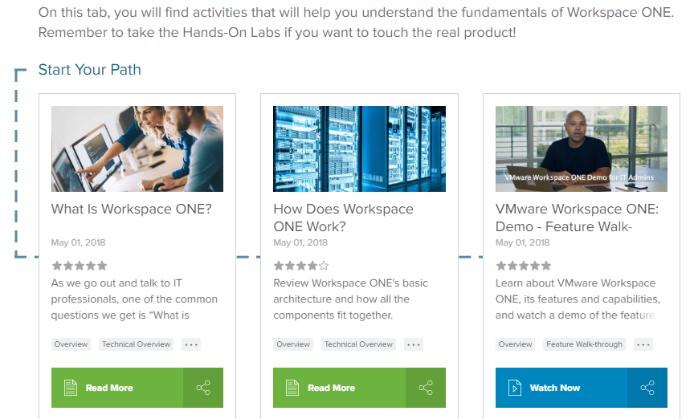
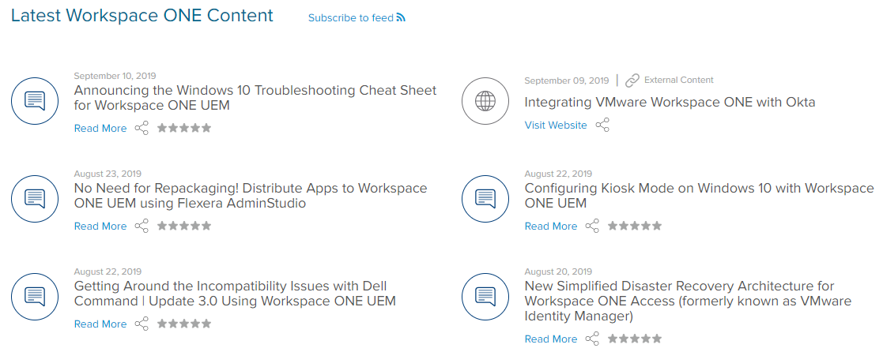
What Can I Get from Digital Workspace Tech Zone? https://techzone.vmware.com/resource/welcome-vmware-digital-workspace-tech-zone
Tools
Latest Content
Reference architectures
Activity paths

Slide 32
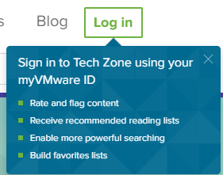
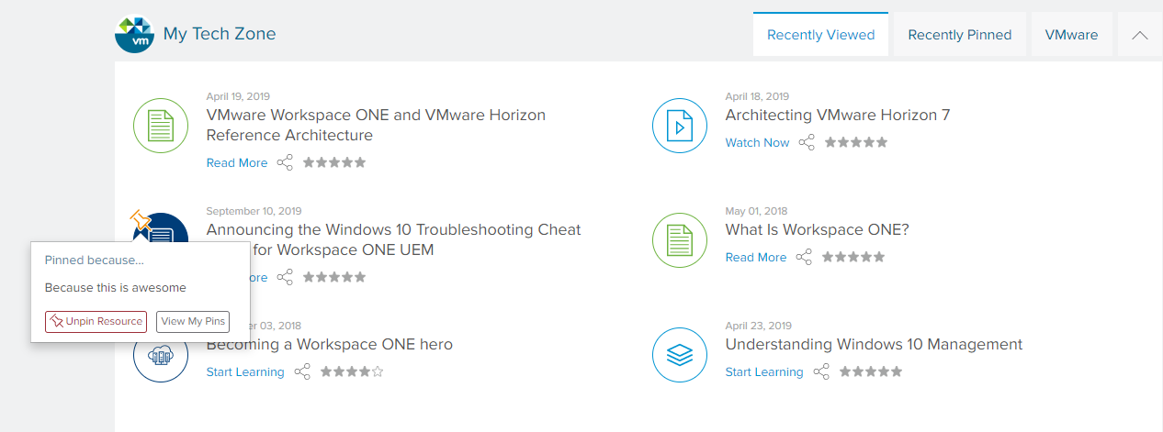
DW Tech Zone – Other Cool Stuff

Slide 33
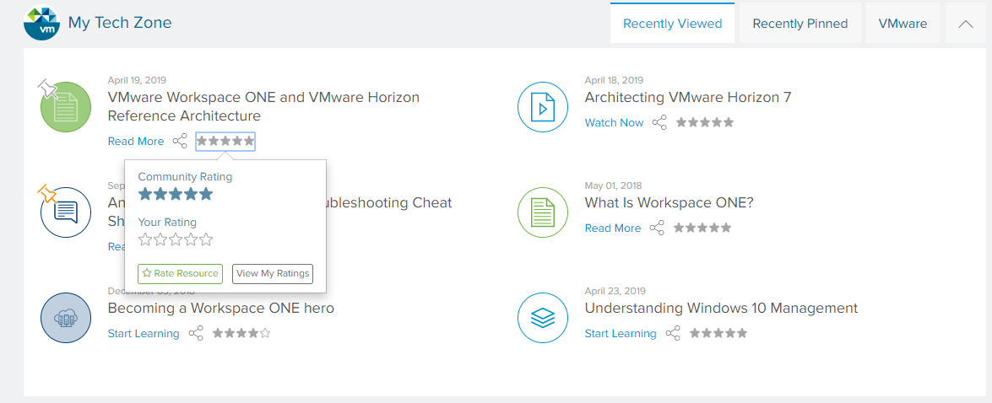
DW Tech Zone – Other Cool Stuff

Slide 34
Workspace ONE Support Site and More…
Support - https://support.workspaceone.com
New KBs - https://support.workspaceone.com/kb?sort=newest
Webinars - https://resources.workspaceone.com/marketing/webinars?sort=newest&version=1811
Forums - https://support.workspaceone.com/forums?sort=newest
Product Announcements - https://support.workspaceone.com/kb/product-announcements?language=en
Notes:
The KBs really just point back to the main VMware KB site, same with new product announcements

Slide 35

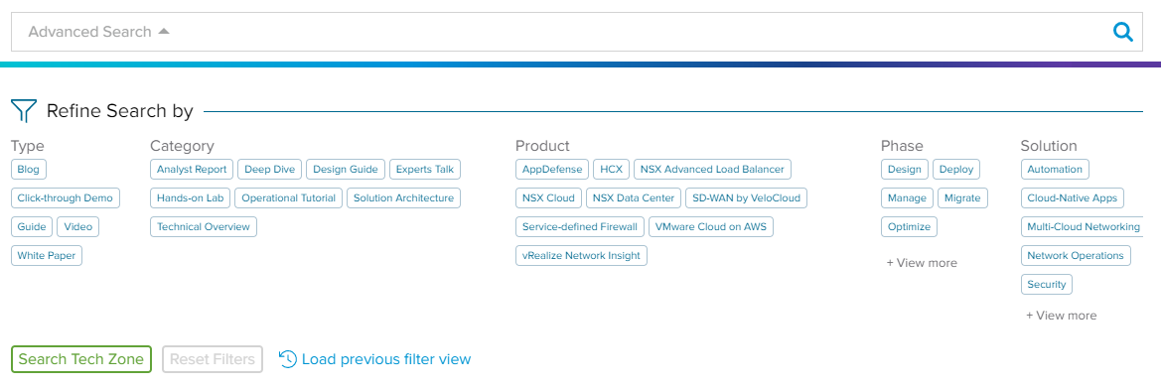
Networking and Security Tech Zone https://nsx.techzone.vmware.com/
Notes:
Pinning, search history, and all other things are here

Slide 36
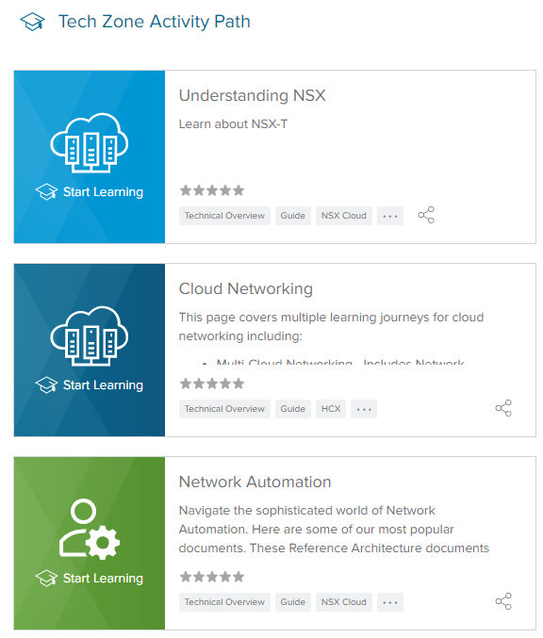
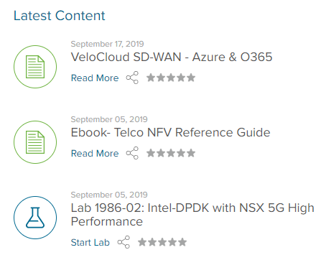
Networking and Security Tech Zone https://nsx.techzone.vmware.com/
Notes:
NSX
NSX and Kubernetes
vRNI
Cloud Networking
VeloCloud
AppDefense
HCX

Slide 37
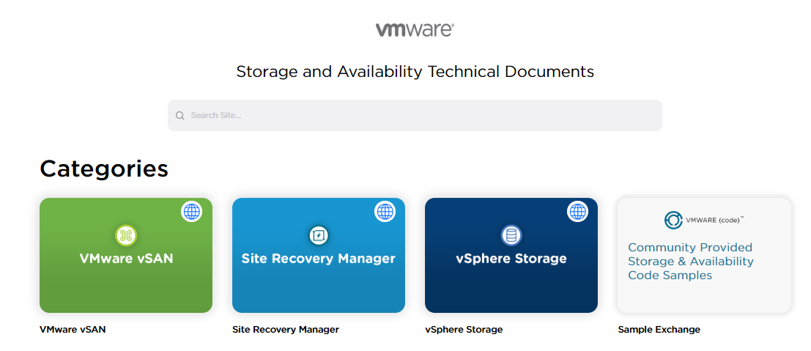
StorageHub https://storagehub.vmware.com/

Slide 38
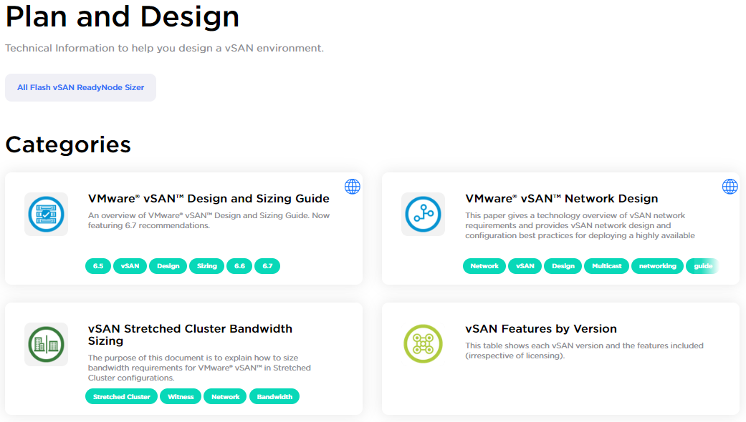
StorageHub – vSAN Goodness

Slide 39
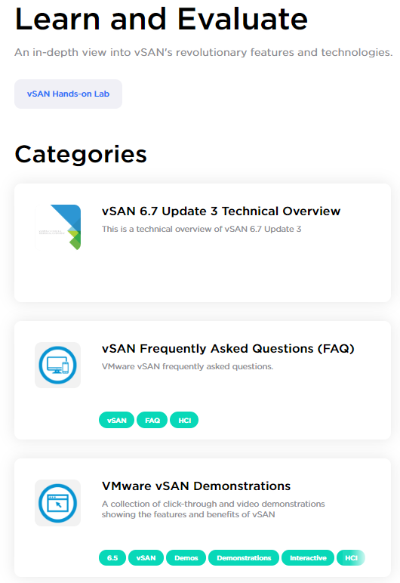
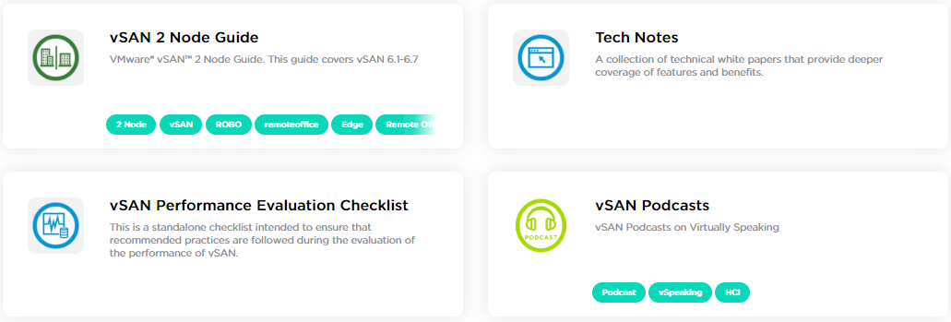
StorageHub – More vSAN Goodness

Slide 40
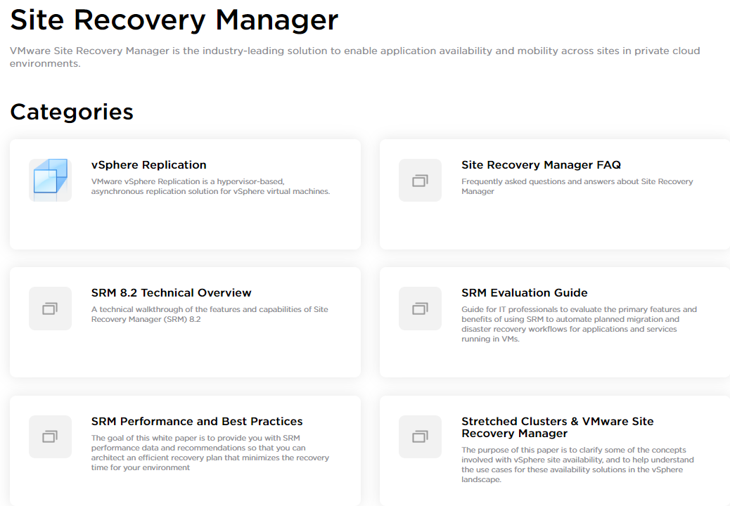
StorageHub - SRM
Notes:
There is even technical support guidance in here (see inside FAQ)
Clarify Site Recovery vs. SRM

Slide 41
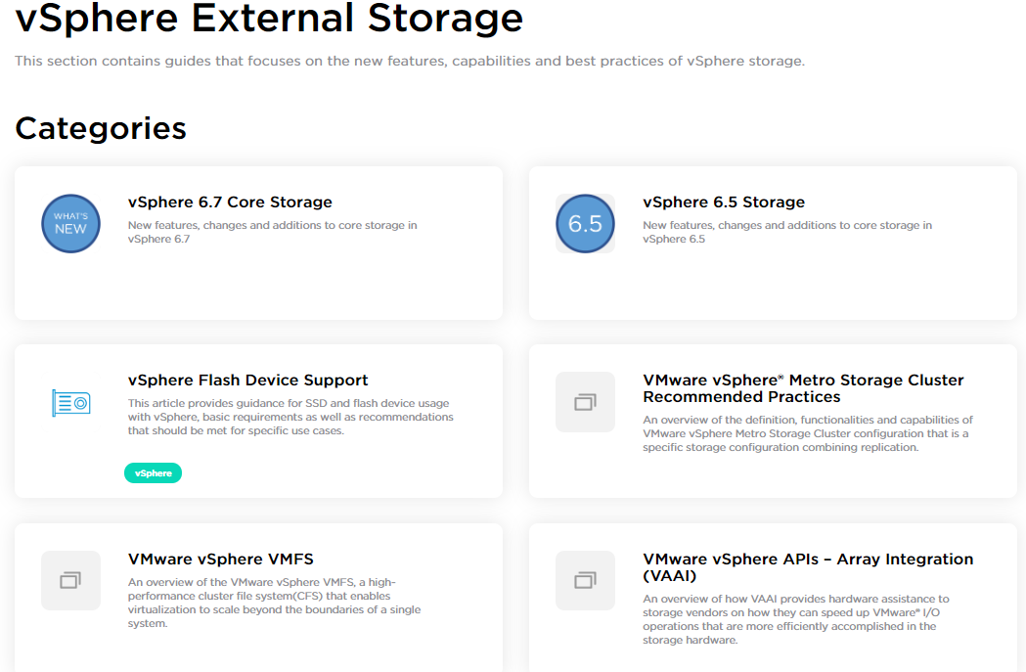
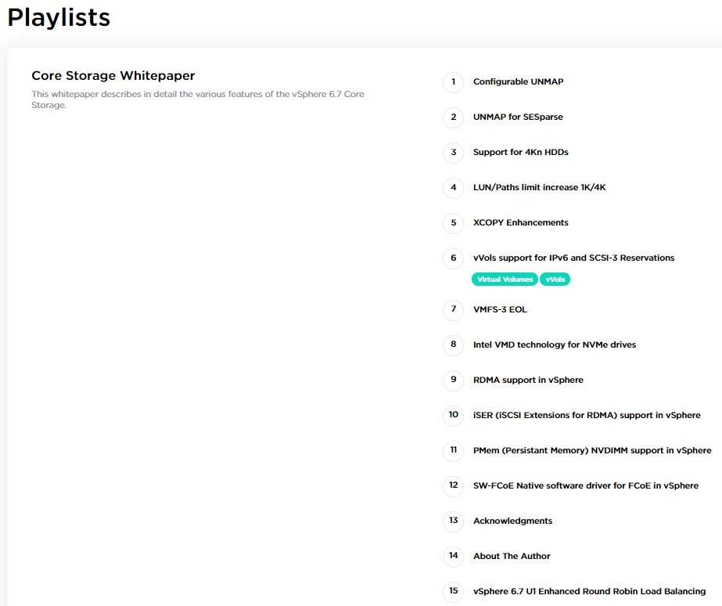
StorageHub – External Storage

Slide 42
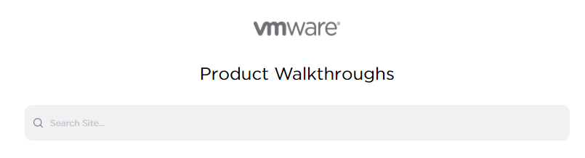


Product Walkthroughs https://featurewalkthrough.vmware.com/
Notes:
Some are links to external sites, some are not
Some not as up to date as others

Slide 43

Product Walkthroughs – Pulse and Azure IoT https://featurewalkthrough.vmware.com/
Notes:
Some are links to external sites, some are not
Some not as up to date as others

Slide 44

vRealize Suite Walkthroughs https://vrealize.vmware.com/

Slide 45

vRealize Suite Walkthroughs https://vrealize.vmware.com/

Slide 46
VMware Solution Exchange https://marketplace.vmware.com/vsx/
A place to find solutions that complement, integrate, or interoperate with VMware solutions
Examples
Third party management packs for vROps / vRA
Endpoint devices (thin clients) and peripherals for use with Horizon
Software that integrates with NSX

Slide 47


vSphere Central https://vspherecentral.vmware.com/
Notes:
Searchable just like StorageHub and others

Slide 48

vSphere Central https://vspherecentral.vmware.com/

Slide 49

vSphere Central https://vspherecentral.vmware.com/

Slide 50

VMware Cloud https://cloud.vmware.com/

Slide 51

VMware Cloud Product FAQs
Notes:
Some sites have videos / links to other resources

Slide 52

VMware Cloud Marketplace https://marketplace.cloud.vmware.com/
Third-party solutions and services, designed and tested to run on VMware-based clouds
Cloud Marketplace Blog - https://cloud.vmware.com/community/vmware-cloud-marketplace/
Notes:
Initial Availbility of Cloud Marketplace - https://cloud.vmware.com/community/2019/08/26/marketplace-initial-availability/

Slide 53

Wavefront Docs https://docs.wavefront.com/

Slide 54

VeloCloud https://www.velocloud.com/sd-wan-resources
SD-WAN 360 Podcast
https://www.velocloud.com/sd-wan-resources/podcasts/sd-wan-360
SD-WAN Webinars
https://www.velocloud.com/sd-wan-resources/webinars
Solution overviews / datasheets
https://www.velocloud.com/sd-wan-resources/briefs
eBooks
https://www.velocloud.com/sd-wan-resources/ebooks

Slide 55

VMware Cloud Community https://cloud.vmware.com/community/
Join the Slack
Sign up for the newsletter
Notes:
Newsletters contain how-tos, industry events, and cloud news
Not the same as VMTN (VMware Technology Network)

Slide 56

Tour Stop # 4
The World as Your Playground

Slide 57

VMware Hands-on Labs https://labs.hol.vmware.com/HOL/catalogs/catalog/all

Slide 58



VMware Hands-on Labs – Hidden Gems https://labs.hol.vmware.com/HOL/catalogs/catalog/all

Slide 59

VMware Hands-on Labs – Lightning Strikes! https://labs.hol.vmware.com/HOL/catalogs/catalog/all

Slide 60

TestDrive – A Step Beyond HOLs https://www.vmwdemo.com https://kb.vmtestdrive.com
Free for VMUG Advantage Members
Free for partners
Free for customers…by invitation only

Slide 61


TestDrive – What Can You Do Here? https://www.vmwdemo.com https://kb.vmtestdrive.com
Notes:
Accelerate Cloud Journey – vSAN, PKS, Kubernetes
Transform Network and Security – vSphere Platinum with AppDefense

Slide 62

VMware Learning Zone https://www.vmware.com/education-services/learning-zone.html
New Additions to VMware Learning Zone
https://blogs.vmware.com/education
Notes:
VMware education and certification blog

Slide 63

Kubernetes Academy https://kubernetes.academy/

Slide 64

Tour Stop # 5
Official Documentation - Docs and KBs

Slide 65


VMware Docs https://docs.vmware.com

Slide 66

Customized VMware Docs? https://docs.vmware.com
Tips and Tricks for Building Customized VMware Docs - http://blog.thenetworknerd.com/2018/12/07/tips-and-tricks-for-building-customized-vmware-docs/

Slide 67


VMware Knowledge Base https://kb.vmware.com/s
KBs and Beyond – Exploring the VMware Knowledge Base Site - http://blog.thenetworknerd.com/2019/01/31/kbs-and-beyond-exploring-the-vmware-knowledge-base-site/

Slide 68

Tour Stop # 6
Blogs, Community, and More

Slide 69


Blog Beat https://blogs.vmware.com/
Aggregation of VMware and VMTN Network member blogs
VMware only feed - https://blogs.vmware.com/all-vmware-blogs
Should you sign up?
Notes:
All feeds searchable

Slide 70
Interesting Blogs to Follow
VMware Cloud Provider Blog
Stay on top of the current news in the world of VMware service providers.
VMware Support Insider
Keep track of the latest set of KBs released, and subscribe to the ones that are most important. Learn about new enhancements to VMware Skyline and other news.
VMware Careers
Did you know we had a careers blog? Maybe this can give candidates some idea of what it's like to be a part of VMware.
VMware Education
Are you paying attention to the certification programs and how they have changed or what new courses might be offered? This is the place.
VMware Open Source Blog
What is VMware up to in the open source world? What is it like to work in the VMware Open Source Technology Center? Get the answers to these questions and more!
VMware Cloud Advocacy Team Blog
If you're trying to develop applications or operate in native public clouds and want to see examples of best practices, this is the place.
VMware Cloud Native Apps Blog
Read when you want or subscribe.

Slide 71
Helpful VMware Podcasts
VMware Communities Roundtable Podcast
https://www.talkshoe.com/show/vmware-communities-roundtable
Virtually Speaking Podcast
https://www.vspeakingpodcast.com/

Slide 72
VMworld On-Demand Video Library https://videos.vmworld.com
Searchable archive of VMworld US / VMworld Europe presentations
Download PDFs of slide decks
Requires a free My VMworld account to sign in
All content free to access

Slide 73

https://code.vmware.com/join
Forums
SDKs
API Reference
Code Samples
Slack channel
Developer Centers
vSphere
Cloud Native
VMConAWS
NSX
WS1

Slide 74

Project Clarity https://clarity.design/
Project Clarity is an open source design system that brings together UX guidelines, an HTML/CSS framework, and Angular components.
Used by over 100 VMware products!
Blog link - https://blogs.vmware.com/opensource/2018/12/04/announcing-clarity-1-0/
GitHub repository link - https://github.com/vmware/clarity/

Slide 75

VMware Technology Network (VMTN) https://communities.vmware.com/welcome
All forums - https://communities.vmware.com/community/vmtn/overview

Slide 76

VMware Design http://vmware.design/research.html
Follow the link to join the VMware Design Studio Program and participate in product feedback studies
VMware Design Blog - https://medium.com/vmwaredesign

Slide 77

VMware Technology Network (VMTN) https://communities.vmware.com/community/vmtn/content

Slide 78


VMware Flings https://flings.vmware.com/

Slide 79

VMware Flings https://flings.vmware.com/

Slide 80

The Journey Continues
Twitter - @NetworkNerd_
Blog – http://blog.thenetworknerd.com
Podcast – http://www.nerd-journey.com

Slide 81


